Slide 1
GROUP J
CAR ADVENTURE
Jane and Jayson

Slide 2
Table of Contents
Introduction
The Original Game
The Modified
Changes
Codes
Reference

Slide 3
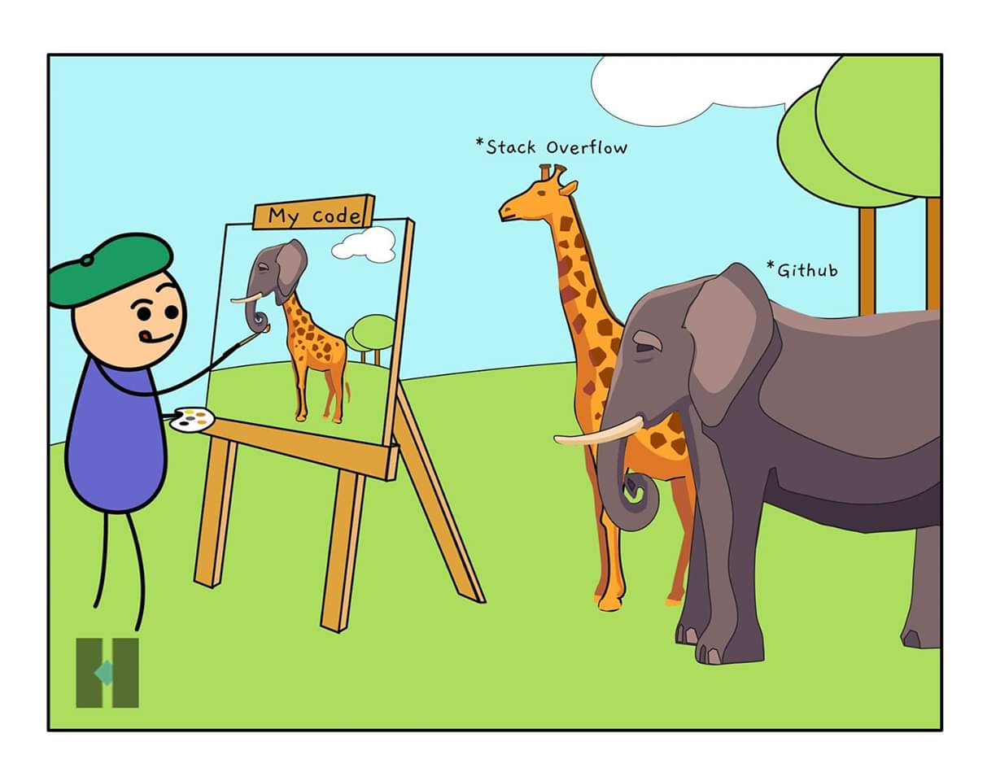

Slide 4
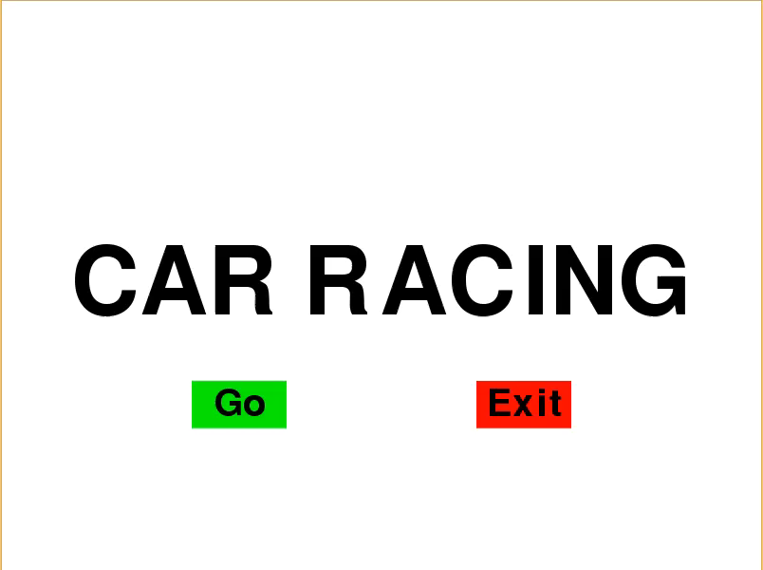

1
ORIGINAL GAME

Slide 5
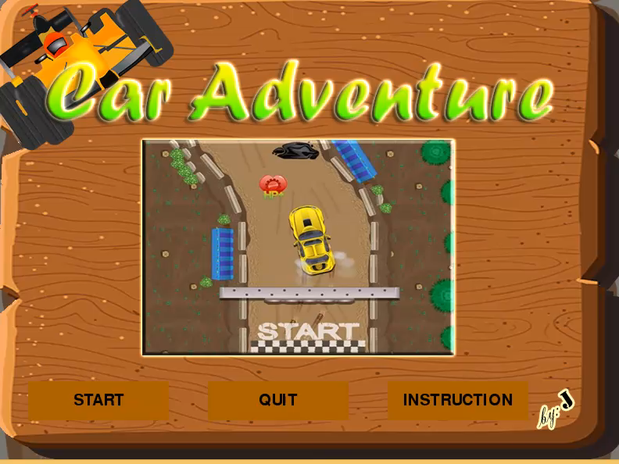

2
MODIFIED GAME

Slide 6
Changes
Change Rules
Allowing to use break, accelerator , pause and keys up and down.
The player has 3 default life.
Adding Levels
Adding more levels to make it more challenging for the users.
Adding coins for points , missile for bullets and additional life
If the player completed all levels until 10 then it’s finished.
Design
Designed layout for menu, pause, instruction and game background.
Adding music, animation, popup message. Starts and Finish

Slide 7
Original
Modified
import pygame
import time
import random
from pygame.locals import *
import pygame.gfxdraw
import pyganim
## install all the necessary module first before you can run this program
##pip install pygame
##pip install Pyganim
pygame.init()
display_width=800
display_height=600
gray=(119,118,110)
black=(0,0,0)
red=(255,0,0)
green=(0,117,50)
blue=(0,121,231)
car_width=55
car_height = 140
bright_red=(251,18,34)
bright_green=(154,240,0)
bright_blue=(7,185,252)
brown =(168,95,0)
lightbrown = (254,196,54)
browngame = (104,73,33)
yellow = (255,211,0)
import pygame
import time
import random
pygame.init()
display_width = 800
display_height = 600
black = (0,0,0)
white = (255,255,255)
green = (0,255,0)
red = (255,0,0)
blue = (0,0,255)
car_width = 50
car_height = 100
#start_music = pygame.mixer.Sound("Hurry_Up.mp3")
pygame.mixer.music.load("Hurry_Up.mp3")
gameDisplay = pygame.display.set_mode((display_width,display_height))
pygame.display.set_caption("Car Racing")
clock = pygame.time.Clock()
svs = pygame.image.load("svs.png")
carImg = pygame.image.load("car1.png") #load the car image
car2Img = pygame.image.load("car2.png")
bgImg = pygame.image.load("back2.jpg")
crash_img = pygame.image.load("crash.png")

Slide 8
Modified
gameDisplay=pygame.display.set_mode((display_width, display_height),0,32)
pygame.display.set_caption(" Car Adventure " )
boltAnim = pyganim.PygAnimation([('bolt_strike_0001.png', 0.2),
('bolt_strike_0002.png', 0.2),
('bolt_strike_0003.png', 0.2),
('bolt_strike_0004.png', 0.2),
('bolt_strike_0005.png', 0.2),
('bolt_strike_0006.png', 0.2),
('bolt_strike_0007.png', 0.2),
('bolt_strike_0008.png', 0.2),
('bolt_strike_0009.png', 0.2),
('bolt_strike_0010.png', 0.2)])
clock=pygame.time.Clock()
carImg=pygame.image.load('car1.png')
coinImg =['coins_01.png','coins_02.png','coins_03.png','coins_05.png','coins_06.png']
bgImg=pygame.image.load("bgImg.png")
instructionbackground=pygame.image.load("menu1.png")
intro_background=pygame.image.load("menufirst.png")
levelSound = pygame.mixer.Sound('up.wav')
missilewindow= pygame.image.load('missilewindow.png')
lifewindow= pygame.image.load('life.png')
speedwindow= pygame.image.load('speed.png')
EnemyImage= ['car.png','car2.png','car3.png','car4.png','car5.png','car6.png','car7.png','car8.png']
bullet = ['laser.png','laser.png']
missile = pygame.image.load('Nitro1.png')
explosion = pygame.image.load('explosion.png')
flame = pygame.image.load('flame.png')
excellent= pygame.image.load('excellent.png')
bonus = ['HP_Bonus.png']
crash = pygame.image.load('crash.png')
FinishImg = pygame.image.load('Finish.png')
missileSound =pygame.mixer.Sound('missile2.wav' )
crashedSound = pygame.mixer.Sound('explosion.wav' )
gameOverSound = pygame.mixer.Sound('gameover.wav')
collect = pygame.mixer.Sound('collect1.wav')
collectMissile = pygame.mixer.Sound('coins.wav')
starts = pygame.mixer.Sound('starts.wav')
explosion = pygame.mixer.Sound('explosion.wav')
introSound = pygame.mixer.Sound('coffee_stains.wav')
clickSound = pygame.mixer.Sound('click.wav')
loseSound = pygame.mixer.Sound('lose.wav')
pause=False
global LIVES, imageX,imageY
LIVES =3
bulletAllow= False
imageX = (display_width/5)
imageY = (display_height/5)

Slide 9
Original
Modified
def intro():
#pygame.mixr.Sound.play(start_music)
intro = True
menu1_x = 200
menu1_y = 400
menu2_x = 500
menu2_y = 400
menu_width = 100
menu_height = 50
while intro:
for event in pygame.event.get():
if event.type == pygame.QUIT:
pygame.quit()
quit()
pygame.display.set_icon(carImg)
pygame.draw.rect(gameDisplay,black,(200,400,100,50))
pygame.draw.rect(gameDisplay,black,(500,400,100,50))
gameDisplay.fill(white)
message_display("CAR RACING",100,display_width/2,display_height/2)
pygame.draw.rect(gameDisplay,green,(200,400,100,50))
pygame.draw.rect(gameDisplay,red,(500,400,100,50))
mouse = pygame.mouse.get_pos()
click = pygame.mouse.get_pressed()
if menu1_x < mouse[0] < menu1_x+menu_width and menu1_y < mouse[1] < menu1_y+menu_height:
pygame.draw.rect(gameDisplay,blue,(200,400,100,50))
if click[0] == 1:
intro = False
if menu2_x < mouse[0] < menu2_x+menu_width and menu2_y < mouse[1] < menu2_y+menu_height:
pygame.draw.rect(gameDisplay,blue,(500,400,100,50))
if click[0] == 1:
pygame.quit()
quit()
message_display("Go",40,menu1_x+menu_width/2,menu1_y+menu_height/2)
message_display("Exit",40,menu2_x+menu_width/2,menu2_y+menu_height/2)
pygame.display.update()
clock.tick(50)
def intro():
intro=True
introSound.play()
while intro:
for event in pygame.event.get():
if event.type==pygame.QUIT:
pygame.quit()
quit()
sys.exit()
gameDisplay.blit(intro_background, (0, 0))
largetext=pygame.font.Font('freesansbold.ttf',80)
button("START",40,500,180,50,brown,lightbrown,"play")
button("QUIT",270,500,180,50,brown,lightbrown,"quit")
button("INSTRUCTION",500,500,180,50,brown,lightbrown,"intro")
pygame.display.update()
clock.tick(50)
def button(msg,x,y,w,h,ic,ac,action=None):
mouse=pygame.mouse.get_pos()
click=pygame.mouse.get_pressed()
if x+w>mouse[0]>x and y+h>mouse[1]>y:
pygame.draw.rect(gameDisplay, ac, (x, y, w, h))
if click[0]==1 and action!=None:
clickSound.play()
if action=="play":
introSound.stop()
countdown()
elif action=="quit":
pygame.quit()
quit()
sys.exit()
elif action=="intro":
instruction()
elif action=="menu":
intro()
elif action=="pause":
paused()
elif action=="unpause":
unpaused()
else:
pygame.draw.rect(gameDisplay, ic, (x, y, w, h))
smalltext=pygame.font.Font("freesansbold.ttf",20)
textsurf,textrect=text_objects(msg,smalltext)
textrect.center=((x+(w/2)),(y+(h/2)))
gameDisplay.blit(textsurf, textrect)

Slide 10
Modified
Original
def instruction():
instruction=True
introSound.stop()
while instruction:
for event in pygame.event.get():
if event.type==pygame.QUIT:
pygame.quit()
quit()
sys.exit()
gameDisplay.blit(instructionbackground, (0, 0))
largetext=pygame.font.Font('freesansbold.ttf',50)
smalltext=pygame.font.Font('freesansbold.ttf',20)
mediumtext=pygame.font.Font('freesansbold.ttf',30)
obtextSurf,obtextRect=text_objects("Collect coins for points, heart for extra life and laser beam for bullets", smalltext)
obtextRect.center=((390),(250))
ob2textSurf,ob2textRect=text_objects('Touching the side-road will be automatically gameover' ,smalltext)
ob2textRect.center=((400),(270))
TextSurf,TextRect=text_objects("INSTRUCTION",largetext)
TextRect.center=((400),(210))
gameDisplay.blit(TextSurf, TextRect)
gameDisplay.blit(obtextSurf, obtextRect)
gameDisplay.blit(ob2textSurf, ob2textRect)
ktextSurf,ktextRect=text_objects("press SPACE BAR : FOR LASER BEAM",smalltext)
ktextRect.center=((243),(540))
ltextSurf,ltextRect=text_objects("press ARROW KEY LEFT : LEFT TURN",smalltext)
ltextRect.center=((238),(510))
rtextSurf,rtextRect=text_objects("press ARROW KEY RIGHT : RIGHT TURN" ,smalltext)
rtextRect.center=((255),(480))
utextSurf,utextRect=text_objects("press ARROW UP : GOING UP ",smalltext)
utextRect.center=((205),(450))
dtextSurf,dtextRect=text_objects("press ARROW DOWN : GOING DOWN" ,smalltext)
dtextRect.center=((240),(420))
atextSurf,atextRect=text_objects("press A : ACCELERATOR",smalltext)
atextRect.center=((178),(390))
btextSurf,btextRect=text_objects("press B : BRAKE ",smalltext)
btextRect.center=((140),(360))
ptextSurf,ptextRect=text_objects("press P : PAUSE ",smalltext)
ptextRect.center=((140),(330))
ctextSurf,ctextRect=text_objects("CONTROLS:",mediumtext)
ctextRect.center=((150),(300))
gameDisplay.blit(ctextSurf, ctextRect)
gameDisplay.blit(ptextSurf, ptextRect)
gameDisplay.blit(btextSurf, btextRect)
gameDisplay.blit(atextSurf, atextRect)
gameDisplay.blit(dtextSurf, dtextRect)
gameDisplay.blit(utextSurf, utextRect)
gameDisplay.blit(rtextSurf, rtextRect)
gameDisplay.blit(ltextSurf, ltextRect)
gameDisplay.blit(ktextSurf, ktextRect)
button("Menu",600,450,100,50,brown,lightbrown,"menu")
pygame.display.update()
clock.tick(30)
def highscore(count):
font = pygame.font.SysFont(None,20)
text = font.render("Score : "+str(count),True,black)
gameDisplay.blit(text,(0,0))
def draw_things(thingx,thingy,thing):
gameDisplay.blit(thing,(thingx,thingy))
def car(x,y):
gameDisplay.blit(carImg,(x,y))
def text_objects(text,font):
textSurface = font.render(text,True,black)
return textSurface,textSurface.get_rect()
def message_display(text,size,x,y):
font = pygame.font.Font("freesansbold.ttf",size)
text_surface , text_rectangle = text_objects(text,font)
text_rectangle.center =(x,y)
gameDisplay.blit(text_surface,text_rectangle)
def crash(x,y):
gameDisplay.blit(crash_img,(x,y))
message_display("You Crashed",115,display_width/2,display_height/2)
pygame.display.update()
time.sleep(2)
gameloop()

Slide 11
Modified
Original
def paused():
global pause
while pause:
for event in pygame.event.get():
if event.type==pygame.QUIT:
pygame.quit()
quit()
sys.exit()
gameDisplay.blit(instructionbackground, (0, 0))
largetext=pygame.font.Font('freesansbold.ttf',115)
TextSurf,TextRect=text_objects("PAUSED",largetext)
TextRect.center=((display_width/2),(display_height/2))
gameDisplay.blit(TextSurf, TextRect)
button("CONTINUE",40,500,150,50,brown,lightbrown,"unpause")
button("RESTART",270,500,150,50,brown,lightbrown,"play")
button("INSTRUCTION",500,500,150,50,brown,lightbrown,"menu")
pygame.display.update()
clock.tick(30)
def unpaused():
global pause
pause=False
def countdown_background():
font=pygame.font.SysFont(None,35)
x=(display_width*0.50)
y=(display_height*0.77)
gameDisplay.blit(bgImg, (0, 0))
gameDisplay.blit(carImg, (x, y))
cointext=font.render("COINS: 0",True, blue)
carshoot=font.render("CAR SHOOT: 0",True, yellow)
score=font.render("SCORE: 0",True,bright_green)
heart=font.render("HEART: 3",True,red)
gameDisplay.blit(heart, (0, 90))
gameDisplay.blit(cointext, (0, 30))
gameDisplay.blit(carshoot, (0, 50))
gameDisplay.blit(score, (0, 70))
def gameloop():
#pygame.mixer.Sound.stop()
pygame.mixer.music.play(-1)
bg_x1 = (display_width/2)-(360/2)
bg_x2 = (display_width/2)-(360/2)
bg_y1 = 0
bg_y2 = -600
bg_speed = 6
bg_speed_change = 0
car_x = ((display_width / 2) - (car_width / 2))
car_y = (display_height - car_height)
car_x_change = 0
road_start_x = (display_width/2)-112
road_end_x = (display_width/2)+112
thing_startx = random.randrange(road_start_x,road_end_x-car_width)
thing_starty = -600
thingw = 50
thingh = 100
thing_speed = 3
count=0
gameExit = False
while not gameExit:
for event in pygame.event.get():
if event.type == pygame.QUIT:
gameExit = True
pygame.quit()
quit()
if event.type == pygame.KEYDOWN:
if event.key == pygame.K_LEFT:
car_x_change = -5
elif event.key == pygame.K_RIGHT:
car_x_change = 5
if event.type == pygame.KEYUP:
if event.key == pygame.K_LEFT or event.key == pygame.K_RIGHT:
car_x_change = 0
car_x+=car_x_change
if car_x > road_end_x-car_width:
crash(car_x,car_y)
if car_x < road_start_x:
crash(car_x-car_width,car_y)

Slide 12
Modified
Original
def countdown():
countdown=True
while countdown:
for event in pygame.event.get():
if event.type==pygame.QUIT:
pygame.quit()
quit()
sys.exit()
gameDisplay.fill(gray)
countdown_background()
largetext=pygame.font.Font('freesansbold.ttf',115)
TextSurf,TextRect=text_objects("3",largetext)
TextRect.center=((display_width/2),(display_height/2))
gameDisplay.blit(TextSurf, TextRect)
pygame.display.update()
clock.tick(1)
starts.play()
countdown_background()
largetext=pygame.font.Font('freesansbold.ttf',115)
TextSurf,TextRect=text_objects("2",largetext)
TextRect.center=((display_width/2),(display_height/2))
gameDisplay.blit(TextSurf, TextRect)
pygame.display.update()
clock.tick(1)
countdown_background()
largetext=pygame.font.Font('freesansbold.ttf',115)
TextSurf,TextRect=text_objects("1",largetext)
TextRect.center=((display_width/2),(display_height/2))
gameDisplay.blit(TextSurf, TextRect)
pygame.display.update()
clock.tick(1)
countdown_background()
largetext=pygame.font.Font('freesansbold.ttf',115)
TextSurf,TextRect=text_objects("GO!!!",largetext)
TextRect.center=((display_width/2),(display_height/2))
gameDisplay.blit(TextSurf, TextRect)
pygame.display.update()
clock.tick(1)
gameloop()
if car_y < thing_starty + thingh:
if car_x >= thing_startx and car_x <= thing_startx+thingw:
crash(car_x-25,car_y-car_height/2)
if car_x+car_width >= thing_startx and car_x+car_width <= thing_startx+thingw:
crash(car_x,car_y-car_height/2)
gameDisplay.fill(green) #display white background
gameDisplay.blit(bgImg,(bg_x1,bg_y1))
gameDisplay.blit(bgImg,(bg_x2,bg_y2))
gameDisplay.blit(svs,(10,(display_height/2)-100))
gameDisplay.blit(svs,(display_width-200-10,(display_height/2)-100))
car(car_x,car_y) #display car
draw_things(thing_startx,thing_starty,car2Img)
highscore(count)
count+=1
thing_starty += thing_speed
if thing_starty > display_height:
thing_startx = random.randrange(road_start_x,road_end_x-car_width)
thing_starty = -200
bg_y1 += bg_speed
bg_y2 += bg_speed
if bg_y1 >= display_height:
bg_y1 = -600
if bg_y2 >= display_height:
bg_y2 = -600
pygame.display.update() # update the screen
clock.tick(60) # frame per sec
intro()
gameloop()
#this is not yet completed there are many changes required to improve this game
#By_Sumit_Patidar

Slide 13
Modified
def score_system(coinCollect, carShoot,score, LIVES):
font=pygame.font.SysFont(None,35)
Collect=font.render("COINS: "+str(coinCollect),True,blue)
Shoot=font.render("CAR SHOOT: "+str(carShoot),True,yellow)
score=font.render("SCORE: " +str(score),True,bright_green)
heart=font.render("HEART: "+str(LIVES),True,red)
gameDisplay.blit(Collect, (0, 30))
gameDisplay.blit(Shoot, (0, 50))
gameDisplay.blit(score, (0, 70))
gameDisplay.blit(heart, (0, 90))
def text_objects(text,font):
textsurface=font.render(text,True,black)
return textsurface,textsurface.get_rect()
def drawObject(obj, x, y):
global gameDisplay
gameDisplay.blit(obj, (x, y))
def GameOver():
explosion.stop()
gameOverSound.play()
Enemy= pygame.image.load(random.choice(EnemyImage))
EnemySize= Enemy.get_rect().size
EnemyWidth = EnemySize[0]
EnemyHeight = EnemySize[1]
EnemyX= random.randrange(200, display_width- 200)
EnemyY = -750
text =(' Game Over ')
largetext=pygame.font.Font("freesansbold.ttf",80)
textsurf,textrect=text_objects(text,largetext)
textrect.center=((display_width/2),(display_height/2))
gameDisplay.blit(textsurf, textrect)
pygame.display.update()
time.sleep(3)
gameloop()
def car(x,y):
gameDisplay.blit(carImg, (x, y))
def gameloop():
global pause,missile,explosion, Enemy, coins,bonus,carShoot,flame, keys, missileXY, LIVES,life
x=(display_width*0.50)
y=(display_height*0.77)
velocity =5
bulletBonus = pygame.image.load(random.choice(bullet))
bulletSize= bulletBonus.get_rect().size
bulletWidth = bulletSize[0]
bulletHeight = bulletSize[1]
bulletX= random.randrange(200, display_width- 200)
bulletY = -750
bulletSpeed=4
bulletAllow = False
LIVES =3
coins = pygame.image.load(random.choice(coinImg))
coinSize= coins.get_rect().size
coinWidth = coinSize[0]
coinHeight = coinSize[1]
coinX= random.randrange(200, display_width- 200)
coinY =-750
life = pygame.image.load(random.choice(bonus))
lifeSize= coins.get_rect().size
lifeWidth = coinSize[0]
lifeHeight = coinSize[1]
lifeX= random.randrange(200, display_width- 200)
lifeY =-750
lifeSpeed=4
coinSpeed=4
Enemy = pygame.image.load(random.choice(EnemyImage))
EnemySize= Enemy.get_rect().size
EnemyWidth = EnemySize[0]
EnemyHeight = EnemySize[1]
EnemyX= random.randrange(200, display_width- 200)
EnemyY =-750
isShot= False
carShoot=0
EnemySpeed=4
degrees = 0
coinCollect=0
carShoot=0
level=0
score=0
y2=7
fps=120
missileXY =[]
gameExit=False

Slide 14
Modified
if bulletAllow == True:
if keys[pygame.K_SPACE]:
missileSound.play()
missileX = x + car_width/5
missileY = y - car_height/2
missileXY.append([missileX,missileY])
if int(score)%10==0:
if bulletAllow == False:
bulletY += bulletSpeed
if bulletY > display_height:
bulletBonus = pygame.image.load(random.choice(bullet))
bulletSize= bulletBonus.get_rect().size
bulletWidth = bulletSize[0]
bulletHeight = bulletSize[1]
bulletX= random.randrange(200, display_width- 200)
bulletY = -750
if score ==100:
gameDisplay.blit(FinishImg, (0, 200))
pygame.display.update()
time.sleep(3)
intro()
if LIVES <= 1:
lifeY += lifeSpeed
if lifeY > display_height:
life = pygame.image.load(random.choice(bonus))
lifeSize= coins.get_rect().size
lifeWidth = coinSize[0]
lifeHeight = coinSize[1]
lifeX= random.randrange(200, display_width- 200)
lifeY =-750
if y<lifeY+lifeHeight:
if y > lifeY and y < lifeY + lifeHeight or y+car_width > lifeY and x+car_height < lifeY+lifeHeight:
if x > lifeX and x < lifeX + lifeWidth or x+car_width > lifeX and x+car_width < lifeX+lifeWidth:
drawObject(excellent, lifeX,lifeY)
life = pygame.image.load(random.choice(bonus))
lifeSize= coins.get_rect().size
lifeWidth = coinSize[0]
lifeHeight = coinSize[1]
lifeX= random.randrange(200, display_width- 200)
lifeY =-750
LIVES+=1
collectMissile.play()
gameDisplay.blit(lifewindow, (imageX, imageY))
pygame.display.update()
time.sleep(3)
while not gameExit:
for event in pygame.event.get():
if event.type==pygame.QUIT:
pygame.quit()
quit()
keys = pygame.key.get_pressed()
if keys[pygame.K_LEFT]:
x -= velocity
if keys[pygame.K_RIGHT]:
x += velocity
if keys[pygame.K_UP]:
y -= velocity
if keys[pygame.K_DOWN]:
y +=velocity
if keys[pygame.K_p]:
paused()
if score >=50:
if keys[pygame.K_a]:
EnemySpeed+=1
if keys[pygame.K_b]:
EnemySpeed-=1
if score< 49:
if keys[pygame.K_a]:
gameDisplay.blit(speedwindow, (imageX, imageY))
pygame.display.update()
time.sleep(3)
if keys[pygame.K_b]:
gameDisplay.blit(speedwindow, (imageX, imageY))
pygame.display.update()
time.sleep(3)

Slide 15
Modified
if y<bulletY+bulletHeight:
if y > bulletY and y < bulletY + bulletHeight or y+car_width > bulletY and x+car_height < bulletY+bulletHeight:
if x > bulletX and x < bulletX + bulletWidth or x+car_width > bulletX and x+car_width < bulletX+bulletWidth:
drawObject(excellent, bulletX,bulletY)
bulletBonus = pygame.image.load(random.choice(bullet))
bulletSize= bulletBonus.get_rect().size
bulletWidth = bulletSize[0]
bulletHeight = bulletSize[1]
bulletX= random.randrange(200, display_width- 200)
bulletY = -750
bulletAllow = True
collectMissile.play()
gameDisplay.blit(missilewindow, (imageX, imageY))
pygame.display.update()
time.sleep(3)
if len(missileXY) !=0:
for bx, by in missileXY:
drawObject(missile, bx,by)
EnemyY += EnemySpeed
if EnemyY > display_height:
Enemy= pygame.image.load(random.choice(EnemyImage))
EnemySize= Enemy.get_rect().size
EnemyWidth = EnemySize[0]
EnemyHeight = EnemySize[1]
EnemyX= random.randrange(200, display_width- 200)
EnemyY = -750
coinY += coinSpeed
if coinY>display_height:
coins= pygame.image.load(random.choice(coinImg))
coinSize= coins.get_rect().size
coinWidth = coinSize[0]
coinHeight = coinSize[1]
coinX= random.randrange(200, display_width- 200)
coinY = -750
rotated = pygame.transform.rotate(coins, degrees)
rect = rotated.get_rect()
pygame.display.update()
gameDisplay.fill(gray)
rel_y= y2 % bgImg.get_rect().height
gameDisplay.blit(bgImg,(0,rel_y-bgImg.get_rect().height))
if rel_y<600:
gameDisplay.blit(bgImg, (0, rel_y))
y2+=EnemySpeed
score_system(coinCollect, carShoot,score, LIVES)
if len(missileXY) != 0:
for i , bxy in enumerate(missileXY):
bxy[1]-=10
missileXY[i][1]= bxy[1]
if bxy[1] <EnemyY:
if bxy[0] > EnemyX and bxy[0] < EnemyX + EnemyWidth:
missileXY.remove(bxy)
isShot= True
carShoot= carShoot+1
score=coinCollect + carShoot
pygame.display.update()
if bxy[1] <= 0:
try:
missileXY.remove(bxy)
except:
pass
if isShot:
Enemy = pygame.image.load(random.choice(EnemyImage))
boltAnim.blit(gameDisplay, (EnemyX, EnemyY))
boltAnim.play()
pygame.display.update()
boltAnim.play()
EnemySize=Enemy.get_rect().size
EnemyWidth= EnemySize[0]
EnemyHeight= EnemySize[1]
EnemyX= random.randrange(200, display_width-200)
EnemyY=-750
isShot= False
pause=True
drawObject(life,lifeX,lifeY)
drawObject(bulletBonus,bulletX,bulletY)
drawObject(Enemy,EnemyX,EnemyY)
y2+=coinSpeed
rotated = pygame.transform.rotate(coins, degrees)
degrees += 2
car(x,y)

Slide 16
if y<coinY+coinHeight:
if y > coinY and y < coinY + coinHeight or y+car_width > coinY and x+car_height < coinY+coinHeight:
if x > coinX and x < coinX + coinWidth or x+car_width > coinX and x+car_width < coinX+coinWidth:
collect.play()
drawObject(excellent, coinX,coinY)
coins = pygame.image.load(random.choice(coinImg))
coinSize=coins.get_rect().size
coinWidth= coinSize[0]
coinHeight= coinSize[1]
coinX= random.randrange(200, display_width-200)
coinY=-750
coinCollect= coinCollect+1
score=coinCollect + carShoot
if int(score)%10==0:
levelSound.play()
level=level+1
EnemySpeed+=2
largetext=pygame.font.Font("freesansbold.ttf",80)
textsurf,textrect=text_objects("LEVEL"+str(level),largetext)
textrect.center=((display_width/2),(display_height/2))
gameDisplay.blit(textsurf, textrect)
pygame.display.update()
time.sleep(3)
if x>690-car_width or x<110:
drawObject(crash, x,y)
explosion.play()
pygame.display.update()
time.sleep(2)
GameOver()
if x>display_width-(car_width+110) or x<110:
drawObject(crash, x,y)
explosion.play()
pygame.display.update()
time.sleep(2)
GameOver()
if y<EnemyY+EnemyHeight:
if y < EnemyY < y+car_height or y < EnemyY+EnemyHeight < y+car_height:
if x < EnemyX < x+car_width or x < EnemyX+EnemyWidth < x+car_width:
boltAnim.blit(gameDisplay, (x, y))
boltAnim.play()
pygame.display.update()
explosion.play()
time.sleep(2)
bulletAllow = False
car(x,y)
Enemy= pygame.image.load(random.choice(EnemyImage))
EnemySize= Enemy.get_rect().size
EnemyWidth = EnemySize[0]
EnemyHeight = EnemySize[1]
EnemyX= random.randrange(200, display_width- 200)
EnemyY = -750
LIVES -=1
if LIVES >= 1:
loseSound.play()
text = (' You lose one life')
largetext=pygame.font.Font("freesansbold.ttf",80)
textsurf,textrect=text_objects(text,largetext)
textrect.center=((display_width/2),(display_height/2))
gameDisplay.blit(textsurf, textrect)
pygame.display.update()
time.sleep(2)
if LIVES ==0:
GameOver()
else:
pass
gameDisplay.blit(rotated, (coinX, coinY))
pygame.display.update()
clock.tick(60)
intro()
gameloop()
pygame.quit()
quit()
Modified

Slide 17
References
Pygame/python
https://www.pygame.org/docs/
https://www.python.org/downloads/
https://www.youtube.com/results?search_query=newboston+pygame
Youtube
https://stackoverflow.com/
stackoverflow
https://freesound.org
FreeSound
https://github.com/jaysonDProgrammer/Car-Modifying-
Github

Slide 18


GROUP J
Ming Chuan University
International Applied Computing
Jayson D. Fernandez
Jane Chen

